Slide 1

Emulate G-sensor on Emulator
HOST: Ubuntu10.10 kernel version 2.6.35
azhe_liu
2011.1.7

Slide 2
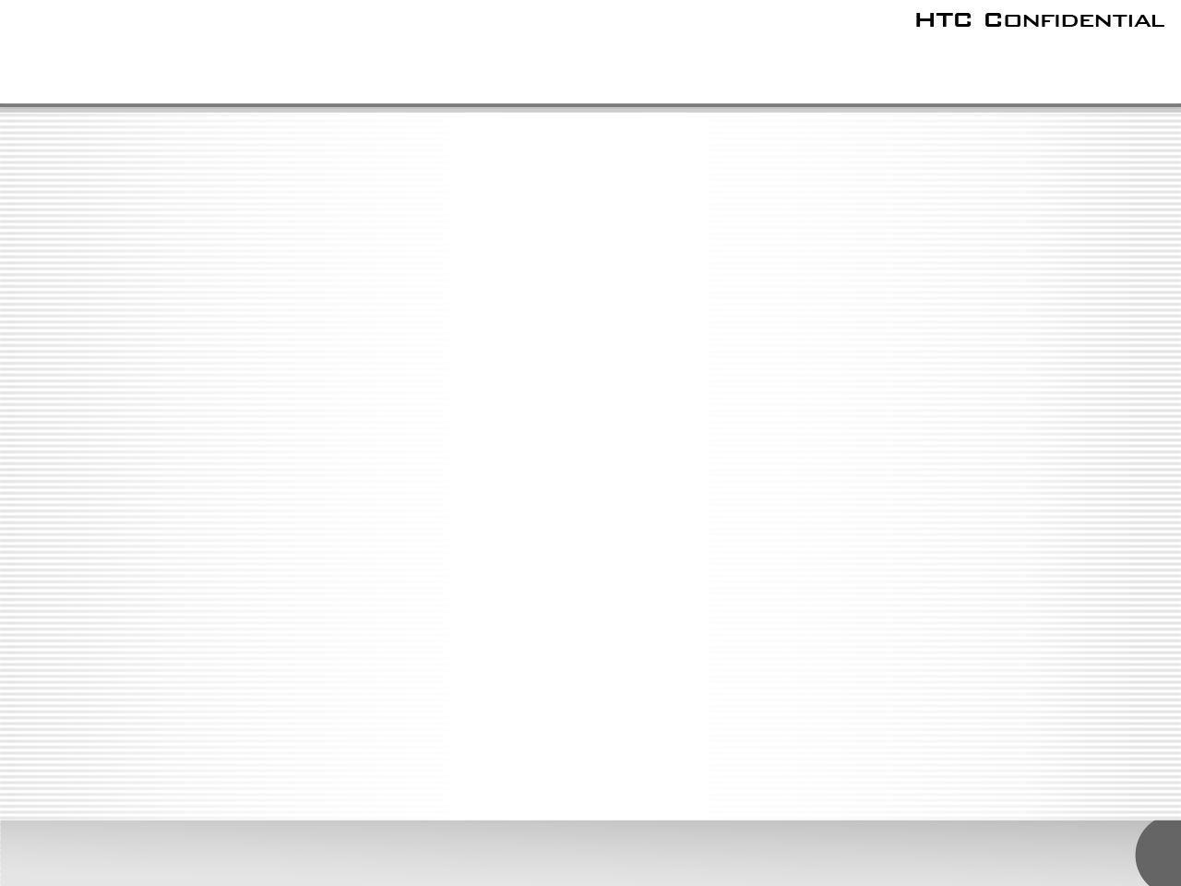


Outline
1.Setup Android Emulator
  1.1Bulid Android
  1.2Build Linux kernel
  1.3Setup emulator
2.Emulate G-sensor
  2.1Modify sensor source
  2.2Rotate screen

Slide 3
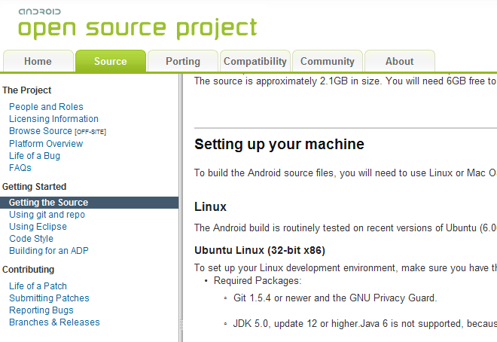
1.1Build Android
1.1.1Get Android source
  Access http://source.android.com
  According to the guid, step by step.

Slide 4
1.1Build Android
Setting up your machine
$ sudo apt-get install git-core gnupg flex bison gperf libsdl-dev libesd0-dev libwxgtk2.6-dev build-essential zip curl libncurses5-dev zlib1g-dev
Note: The command don't include [option] sun-java5-jdk ,because it change, we will get it later.
Installing Repo
$ cd ~
$ mkdir bin
#add "PATH=$PATH:~/bin" to th file
$sudo vim /etc/profile
$source /etc/profile
$cd ~/bin
#download repo
$ curl http://android.git.kernel.org/repo >~/bin/repo
$ chmod a+x ~/bin/repo
Initializing a Repo client
$mkdir mydroid
$cd mydroid
$ repo init -u git://android.git.kernel.org/platform/manifest.git -b froyo
Getting the files
$repo sync

Slide 5
1.1Build Android
1.1.2 Get JDK
HOW get it: Google JDK to click the ORACLE website. Click "download",to find "JDK 5.0 Update 22". After you download JDK. Copy it to your $HOME, then you can refer to commands below.
#uncompress
$./jdk-1_5_0_22-linux-i586.bin
#then add "~/jdk1.5.0_22/bin" to $PATH.
$sudo vim /etc/profile
$source /etc/profile
1.1.3 Build android source
$ cd ~/mydroid
$ source build/envsetup.sh
$export ANDROID_JAVA_HOME=~/jdk1.5.0_22/
$ make -j6To emulate a device,the minimal requried image files are the following:
At last,we get "ramdisk.img","system.img","userdata.img", in dir "out/target/product/generic/".
kernel-qemu: the emulator-specific linux kernel
ramdisk.img :used to boot the system
system.img :the "initial" system image
userdata.img :the "initial" data partition image.

Slide 6
1.2Build kernel
1.2.1 Get kernel source
Access http://android.git.kernel.org/ ,to find a comportable kernel. We chose "Common
Android Kernel Tree".Refer to the commands below.
$mkdir ~/kernel_common
$cd ~/kernel_common
#get source
$git clone git://android.git.kernel.org/kernel/common.git
#list all branch
$git branch -a
#checkout goldfish to location.
$git checkout origin/archive/android-gldfish-2.6.29 -b android-gldfish-2.6.29
1.2.2 Get toolchain
Get "toolchain-eabi-4.4.0.tgz" from share dir.Copy it to $HOME .Then Refer to the commands below.
#uncompress to be toolchain-eabi-4.4.0/
$sudo tar zxvf toolchain-eabi-4.4.0.tgz
#add "~/ toolchain-eabi-4.4.0/bin/" to $PATH
$sudo vim /etc/profile
$source /etc/profile

Slide 7
1.2Build kernel
1.2.3 Build kernel source
At first,we should modify Makefile and choose comportable configeration.Refer to the commands below.
$cd ~/kernel_common
$sudo vim Makefile
Then modify "ARCH ?=arm", "CROSS_COMPILE ?=arm-eabi-",at about 190 lines.
#choose comportable config file
$cp arch/arm/configs/goldfish_defconfig .config
$make menuconfig
$make -j6
At last,we get "arch/arm/boot/zImage".

Slide 8
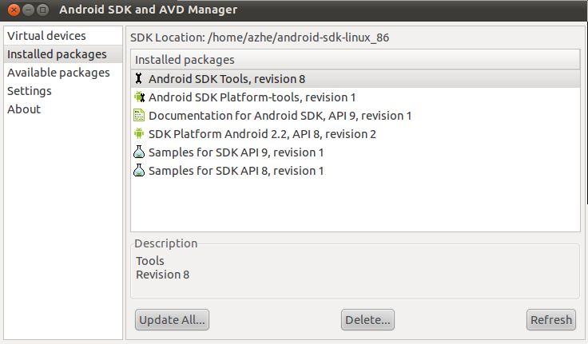
1.3Setup emulator
1.3.1 Get Android SDK
Access http://androidappdocs.appspot.com ,to download comportable JDK. Then refer to the commands below.
$cd ~
#uncompress
$tar zxvf android-sdk_r08_linux_86.tgz
$cd android-sdk_linux_86/tools
#install componments
$./android
choose componments in graphics window refer to the right figuer.
#modify $PATH
$sudo vim /etc/profile
#Then add "tools/","platform-tools" to $PAHT.

Slide 9

1.3Setup emulator
1.3.2 start emulate
Then refer to the commands below.
$emulator -system system.img -kernel zImage -data userdata.img -ramdisk ramdisk.img
-show-kernel -shell
At last,you will see a customization-emulator.
should be filepath.
show kernel information and start shell.

Slide 10

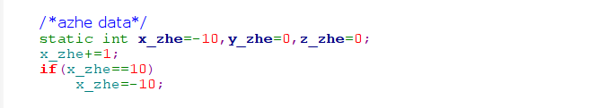
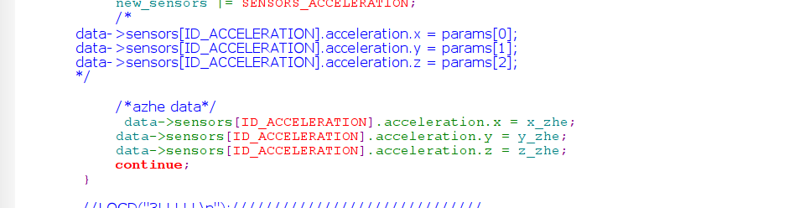
2.1 Modify sensor source
Modify mydroid/sdk/emulator/sensors_qemu.c
#First,Enable log debug.
#Then modify data which you will report. Refer to figures below.

Slide 11
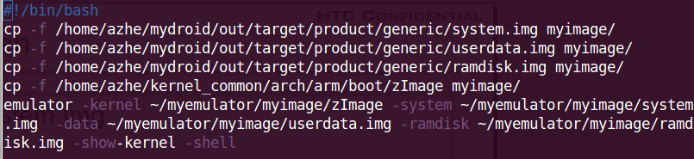
2.2 Rotate screen
2.2.1 Restart emulator
#build module
$cd mydroid/sdk/emulator/sensor/
$mm
#creat new system.img
$cd mydroid
$make snod
$./startemulator #content below

Slide 12
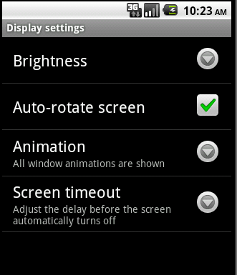
2.2 Rotate screen
2.2.2 Setting
In emulator, "setting->display->Auto-rotate screen". Then screen rotate.

Slide 13
That's all, Thank you!

